Slide 1
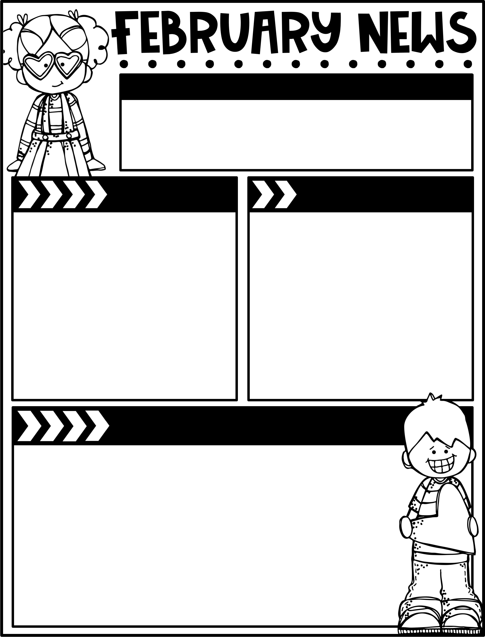
February 3, 2025
The Moreau Heights family is committed to providing a positive and safe learning environment to support responsible and productive citizens.
Phone:
573-659-3180
Plan Time:
1:35-2:25 pm
Emails:
mason.johnson@jcschools.us
danielle.mcgeorge@jcschools.us
theresa.schell@jcschools.us
Calendar
Learning Targets
M 02/03 B Day
TU 2/4 C Day
W 2/5 A Day
Th 2/6 B Day
F 2/7 C Day, Library Checkout
M 02/10 PTO Meeting, 6 pm @ MH Library
Th 02/13 Spring Picture Day
M 2/17 No School- Presidents’ Day
Reading/Writing
I can read independently & answer written multiple-choice questions about key details in the text.
I can identify correct proper noun forms.
I can rewrite singular nouns as plurals.
I can complete fill in the blank sentences with the correct form of the verb to be.
Math
I can relate the clock to a number line to count by fives.
I can tell time to the nearest 5 minutes.
Science
I can discuss quick changes to Earth’s surface.
Things to Know
Specials Schedule:
Library Check-Out:
Second grade has check-out on Fridays! Please help your child remember their books!
SECOND STEP LESSON 13:
Having Empathy
Summary
In this week’s lesson, your child
will practice having empathy to
come up with kind acts they
could do for others in different
situations.
Try This at Home
Ask your child how having
empathy can help them know
how to be kind.
 | Mr. J | Mrs. M | Ms. S
A | Music | PE | Art
B | PE | Art | Music
C | Art | Music | PE

